Slide 1
The Pure C++ Workshop
By Mike Young

Slide 2
Introduction
Flix Interactive is an Unreal Engine specialist organization.
Many who work here have an Unreal Engine framed C++ background or education.
Yet there is great value in knowing how to use C++ outside Unreal Engine.

Slide 3
What this workshop will aim to do
Teach the basic syntax needed to survive in a codebase without Unreal Engine’s types or frameworks.
By the end you should:
Know how to make a C++ project (without Unreal Engine).
The different common parts of the STD library.
Have the confidence to use online compiler tools (Like godbolt.org, rextester.com or quick-bench.com).

Slide 4
Topics which will be covered
Creating a local C++ project
Printing to the console
Integers & mathematics
The Basic array type
Dynamic array types
Strings
Wide Strings
Vectors vs Arrays
Maps
Casting
File IO

Slide 5
What this workshop will not cover
Any advanced topics for software engineering which you won’t already know. Such as:
Compilers (at least not in-depth)
Preprocessors and Templates
Threads
Dynamic/static Linking
Pointer Arithmatic
Intrinsics
Variadics

Slide 6
Setting up a project
(Houston, we have lift off!)

Slide 7
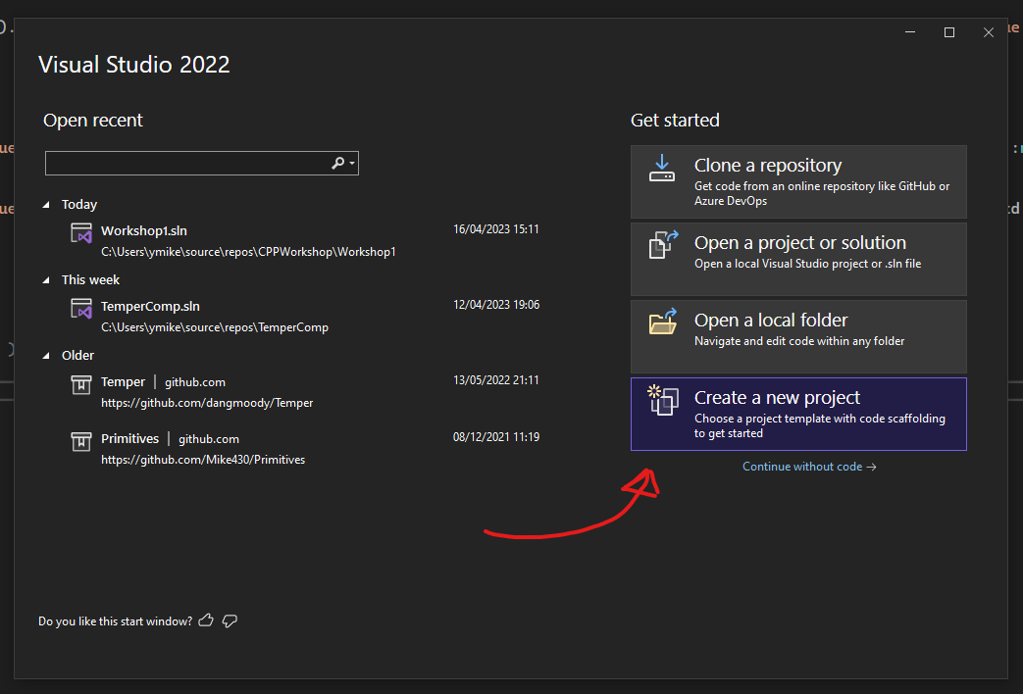
Creating a C++ project
Open visual studio
Click “Create a new Project”
SEE NEXT SLIDE

Slide 8
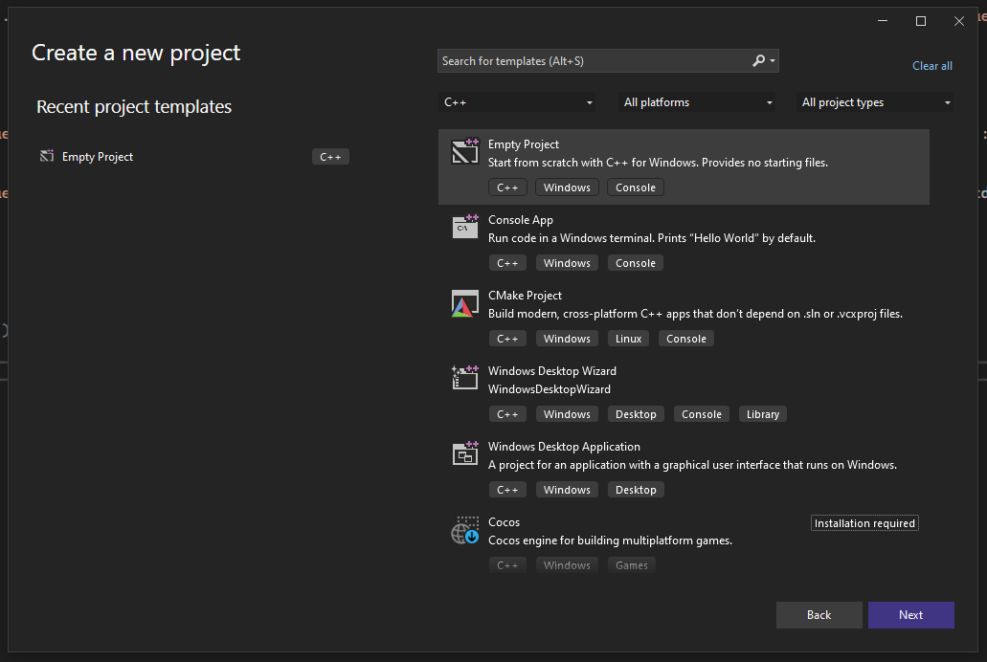
Creating a C++ project
From the list select “Empty Project”
Click “Next”
SEE NEXT SLIDE

Slide 9
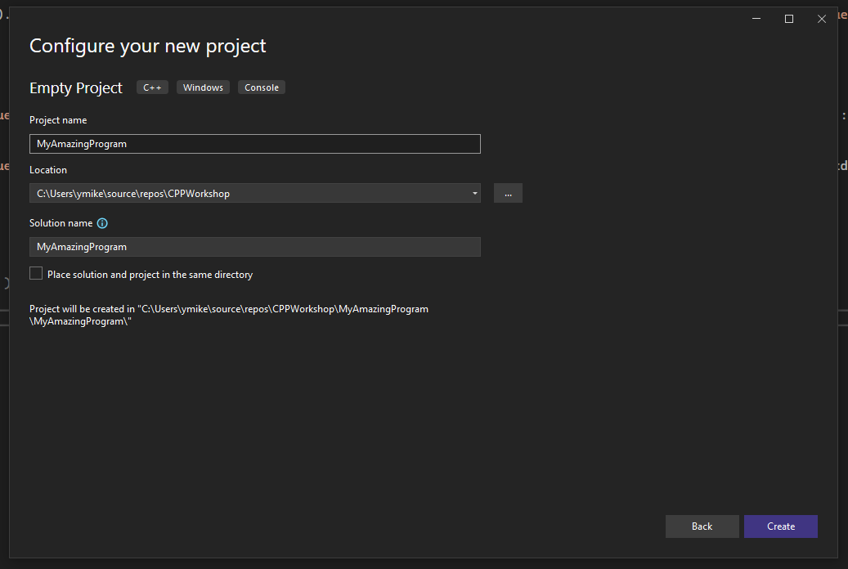
Creating a C++ project
Give the new project a name and a directory to be created in.
Your solution and project names do NOT need to match
Don’t enable “Place solution and project in the same directory”
Click “Create”

Slide 10
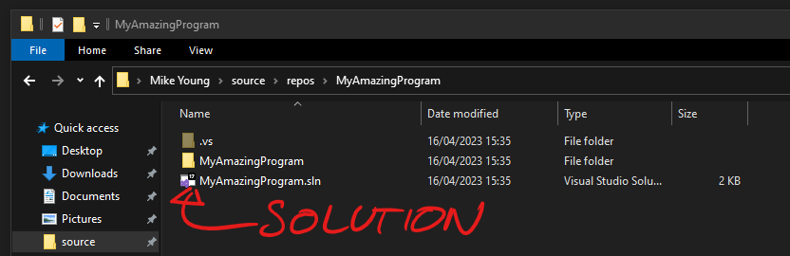
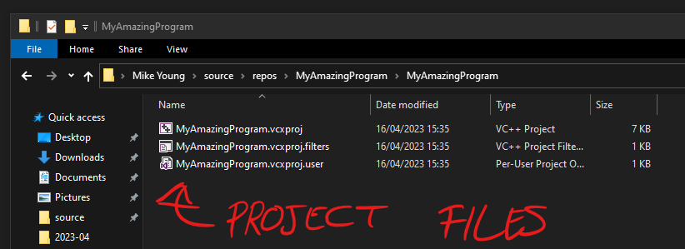
Creating a C++ project
Visual studio will now be open for you to work in.
In the file explorer, you will see a .sln file for your solution, and a folder for your project.
The project folder will contain the project files. One solution may have many projects.

Slide 11
Printing text
(Time to take a dump)

Slide 12
Integers and Math Functions
(Urgh, oooh. IDK, I never counted. I’m not really a math guy 😹)

Slide 13
Integers
For integers in non-unreal engine projects you will want to use the “stdint” header.
 | 8 | 16 | 32 | 64 | 8 unsigned | 16 unsigned | 32 unsigned | 64 unsigned
Unreal | int8 | int16 | int32 | int64 | uint8 | uint16 | uint32 | uint64
C++ | Char | Short | Int | long or long long | unsigned char | unsigned short | unsigned int | unsigned long or unsigned long long
Stdint.h | int8_t | int16_t | int32_t | int64_t | uint8_t | uint16_t | uint32_t | uint64_t

Slide 14
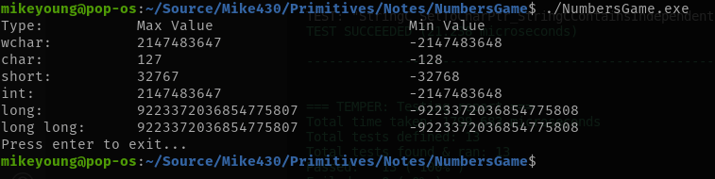
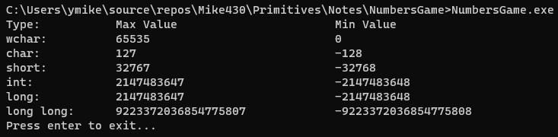
Why you’ll want to use stdint’s typedefs

Slide 15
Your common math headers
#include <stdint.h> // typedef-ed ints that are of a fixed type across platforms
#include <cmath.h> // C99 math utilities
#include <math.h> // The same C99 math utilities but contextualised for C++ STD namespaces. Never noticed or been fussed by any differences so mileage may vary
Full list of cmath.h/math.h functions available here:
https://cplusplus.com/reference/cmath/

Slide 16
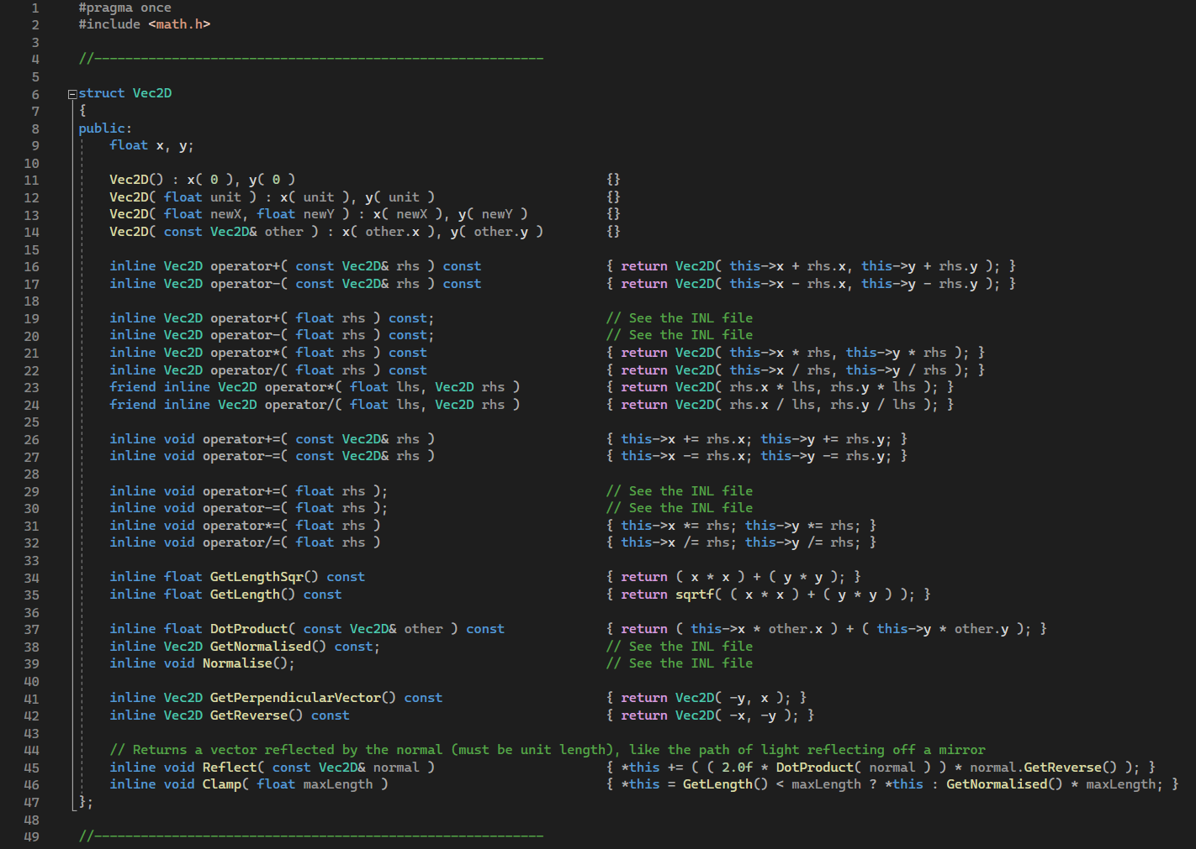
Mathematics warning about base C++
THERE ARE NO IMPLEMENTATIONS OF VECTORS, TRANSFORMS OR QUATERNIONS
Such maths concepts either need to be specified or will be provided by whichever framework/engine you end up working with.

Slide 17
Basics of Arrays
(Explaining the fundamentals behind all dynamic size types)

Slide 18

The basics of arrays
A types’ size must be known at compile time, this is a hard rule.
With that in mind, how do strings, arrays, maps, etc work? Isn’t the whole point that their size is unknown?

Slide 19
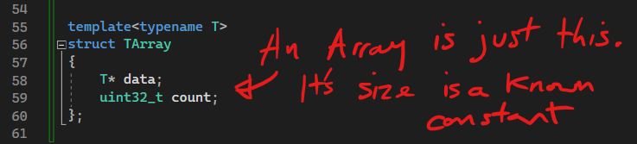
The fundamentals of an array structure
All supposedly “variable-sized” objects contain a pointer out to the heap.
This memory on the heap is of a fixed size.
If the size needs to change, the memory is reallocated.

Slide 20
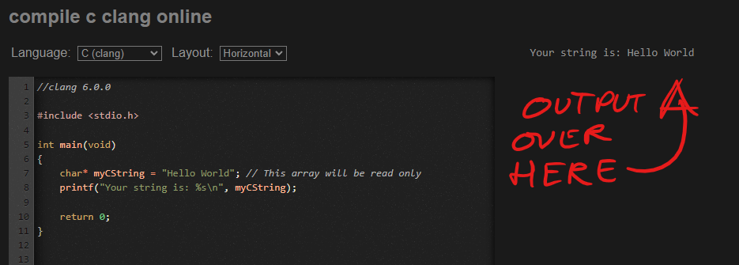
Arrays are just pointers, demonstrated
“char*” denote a “C string” or “C style string” and is the simplest dynamic* array type.

Slide 21
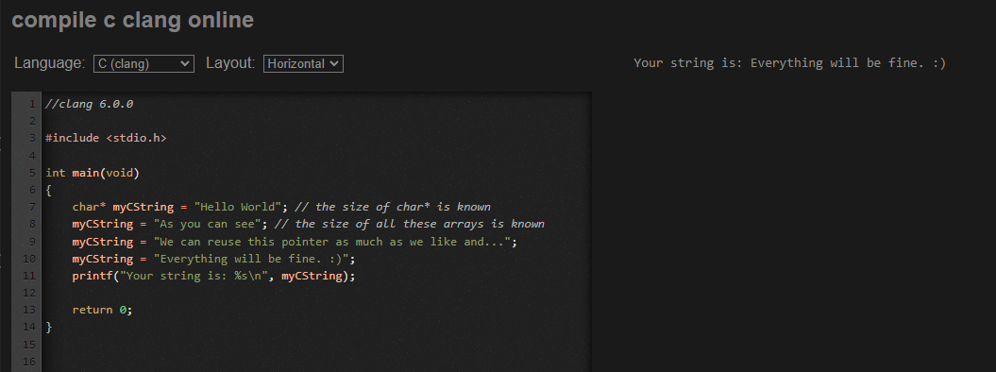
Arrays are just pointers, demonstrated
As you can see, a char* has the power to act exactly like a Tarray and point at many different memory blocks
These various arrays are all discarded at the end of the scope.

Slide 22
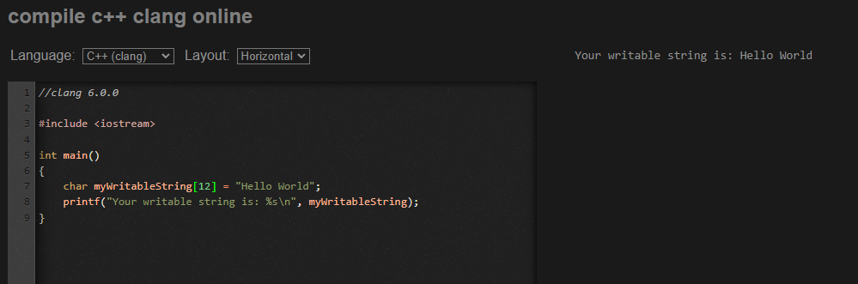
For fullness of clarity
(This is the standard syntax for the most basic stack allocated array, if you wish to embed the memory into something. This data at least is not read only)

Slide 23
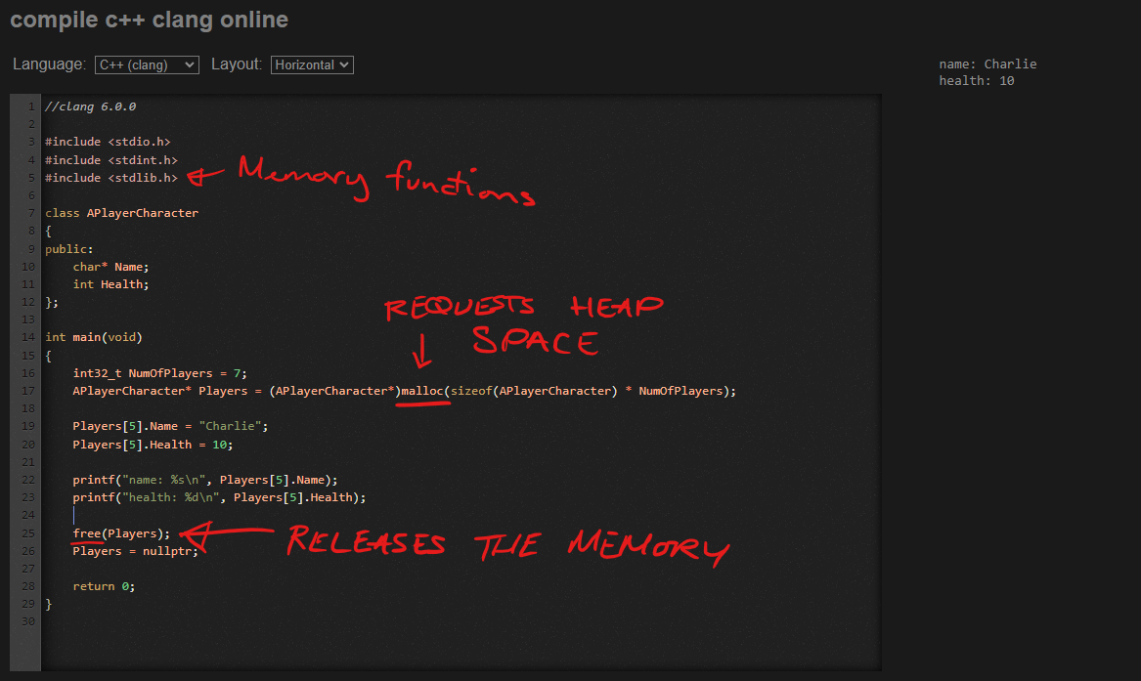
A more practical demonstration
Pointers do not denote the size of the memory they point to, merely the address (and type at compile time), so you can use the [] operator to offset it.

Slide 24
Malloc and Free warning!
Construstors and Destructors are C++ concepts. The C99 functions for allocating and deallocating data will not invoke Constructors nor Destructors.
Malloc | Free | New | Delete
Grabs memory | Releases memory | Grabs memory | Calls destructor
 |  | Builds VTable | Releases memory
 |  | Calls constructor

Slide 25
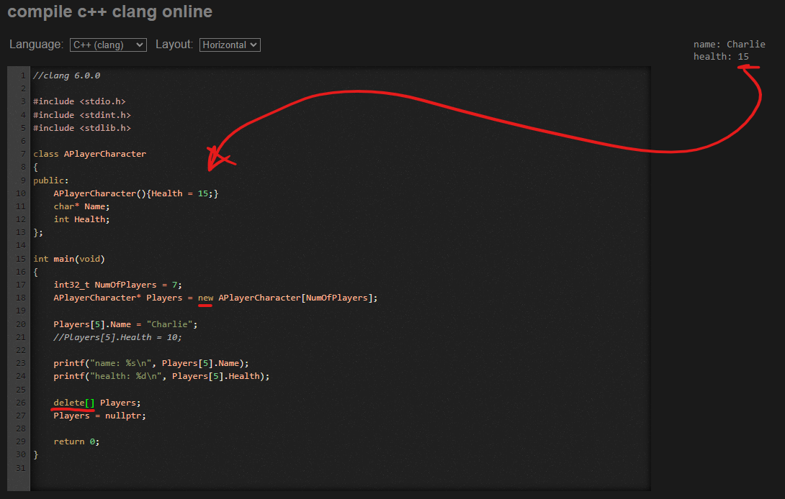
C++ new & delete equivalents

Slide 26
Array basics conclusion
An array is either
Of a fixed size that is known at compile time or…
A pointer to a changing region/block of memory
You can allocate and manage your own memory using malloc() and free() or the “new” and “delete” keywords
Extra reading:
Other useful C99 memory functions that will be useful/common in subjects of memory management include:
realloc() // reallocate – moves a given memory block to somewhere bigger
calloc() // contiguous allocation – same as malloc but formats memory to zero and takes different params
memcpy() // copies memory
etc… // there are more I’m probably forgetting 🤷‍♂️

Slide 27
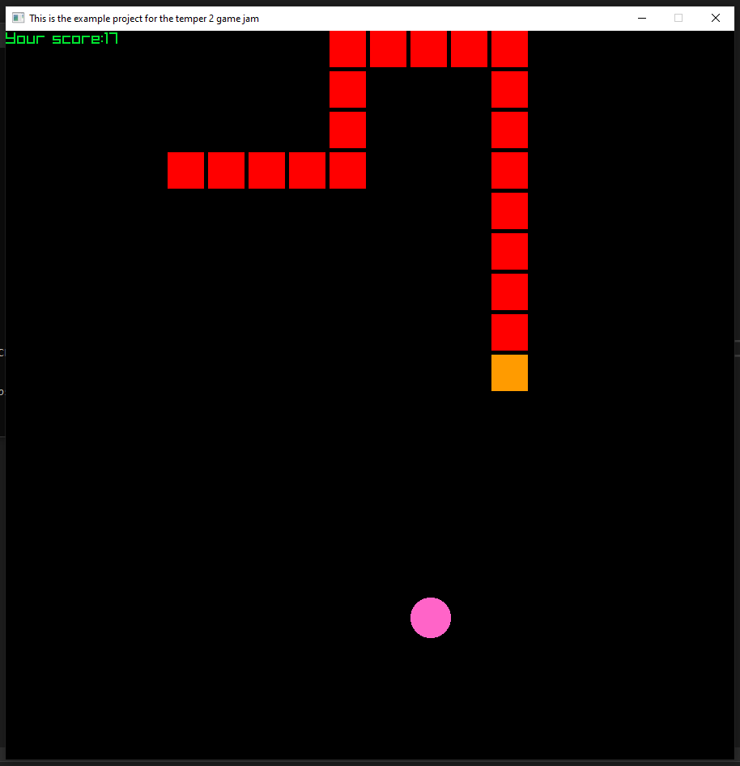
Now that you know the basics…
You can download a simple C++ snake game to experiment with from:
https://github.com/Mike430/TemperComp.git

Slide 28
Any questions?
Want me to go over anything more indepth?

Slide 29
Thanks for tuning into my TED talk

